Slide 1
8-7 MOS Technology
MOS technology derives its name from the basic structure of a metal electrode, over an oxide insulator, over a semi-conductor substrate.
Transistors of MOS technology are field-effect transistors—called MOSFETs.
The electric field on the metal electrode side of the oxide insulator has an effect on the resistance of the substrate.
Most of the MOS digital ICs are constructed entirely of MOSFETs and no other components.
MOSFETs are relatively simple and inexpensive to fabricate, small, and consume very little power.
Digital Systems: Principles and Applications, 11/e
Ronald J. Tocci, Neal S. Widmer, Gregory L. Moss

Slide 2
8-7 MOS Technology
The principal disadvantage of MOS devices is their susceptibility to static-electricity damage.
Although minimized by proper handling, TTL is still more durable for laboratory experimentation.
Digital Systems: Principles and Applications, 11/e
Ronald J. Tocci, Neal S. Widmer, Gregory L. Moss

Slide 3
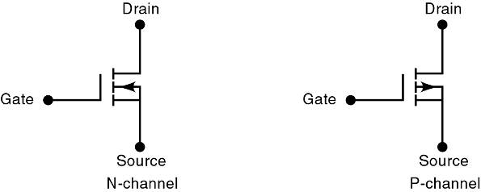
8-7 MOS Technology
There are presently two general types of MOSFETs—depletion and enhancement.
MOS ICs use enhancement MOSFETs exclusively.
The direction of the arrow indicates either P- or N-channel. The symbols show a broken line between the source and the drain to indicate there is normally no conducting channel between these electrodes.
Digital Systems: Principles and Applications, 11/e
Ronald J. Tocci, Neal S. Widmer, Gregory L. Moss

Slide 4
8-7 MOS Technology – Basic MOSFET Switch
An N-channel MOSFET is the basic element in a family of devices known as N-MOS.
Drain is always biased positive relative to the source.
Digital Systems: Principles and Applications, 11/e
Ronald J. Tocci, Neal S. Widmer, Gregory L. Moss

Slide 5
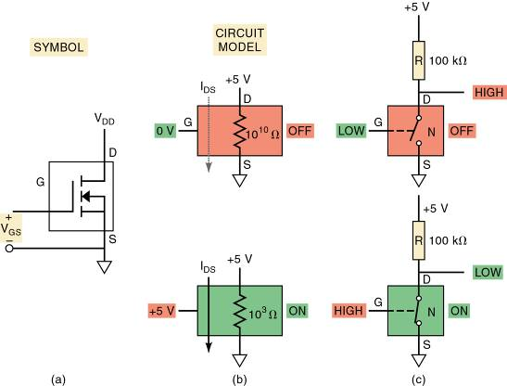
8-7 MOS Technology – Basic MOSFET Switch
Gate-to-source voltage V_{GS} is the input voltage.
Used to control resistance between drain & source.
Determines whether the device is on or off.
Digital Systems: Principles and Applications, 11/e
Ronald J. Tocci, Neal S. Widmer, Gregory L. Moss

Slide 6
8-7 MOS Technology – Basic MOSFET Switch
The P-channel MOSFET—P-MOS—operates in the same manner as the N-channel.
Except that it uses voltages of opposite polarity.
The drain is connected to the lower side of the circuit so it is biased with a more negative voltage relative to the source.
Digital Systems: Principles and Applications, 11/e
Ronald J. Tocci, Neal S. Widmer, Gregory L. Moss

Slide 7
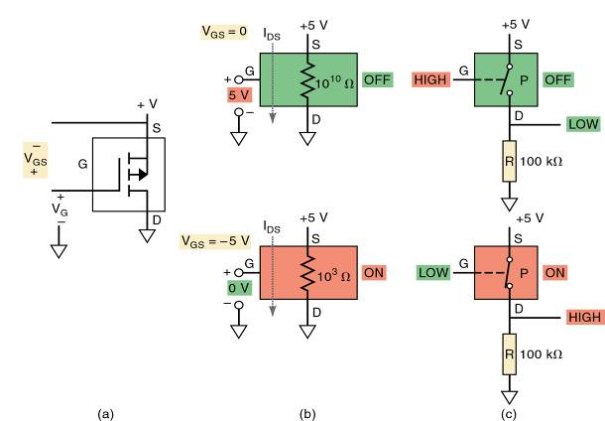
8-7 MOS Technology – Basic MOSFET Switch
To turn the P-MOSFET ON, a voltage lower than the source by V_{T} must be applied to the gate.
Voltage at the gate, relative to the source, must be negative.
Digital Systems: Principles and Applications, 11/e
Ronald J. Tocci, Neal S. Widmer, Gregory L. Moss

Slide 8
8-8 Complementary MOS Logic – CMOS Inverter
P-MOS & N-MOS circuits began to dominate the LSI and VLSI markets in the 1970s and 1980s.
Use fewer components & are much simpler to manufacture than TTL circuits.
During this era, technology emerged that used P-MOS & N-MOS transistors in the same circuit.
Complementary MOS, or CMOS, technology.
Digital Systems: Principles and Applications, 11/e
Ronald J. Tocci, Neal S. Widmer, Gregory L. Moss

Slide 9
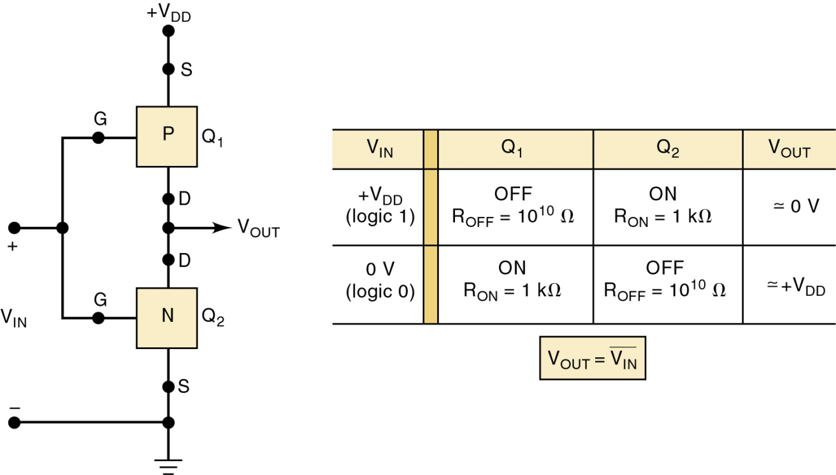
8-8 Complementary MOS Logic – CMOS Inverter
The CMOS INVERTER has two MOSFETs in series.
The P-channel device source is connected to V_{DD} .
The N-channel device has its source connected to ground—usually labeled V_{SS}.
Basic CMOS INVERTER.
Digital Systems: Principles and Applications, 11/e
Ronald J. Tocci, Neal S. Widmer, Gregory L. Moss

Slide 10
8-8 Complementary MOS Logic – CMOS Inverter
The CMOS INVERTER has two MOSFETs in series.
Gates of the two devices are connected together as a common input.
Drains are connected together as common output.
Basic CMOS INVERTER.
Digital Systems: Principles and Applications, 11/e
Ronald J. Tocci, Neal S. Widmer, Gregory L. Moss

Slide 11
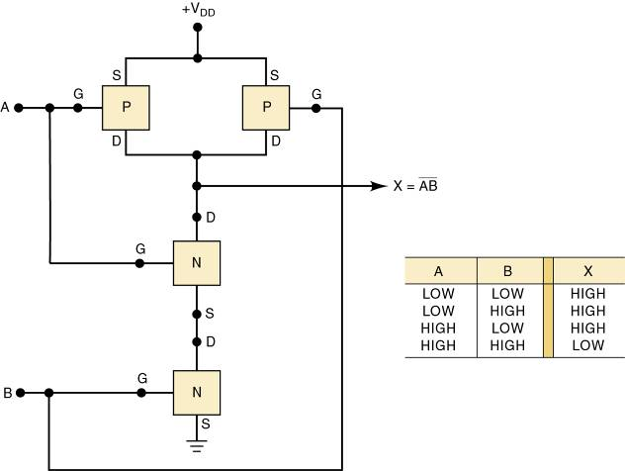
8-8 Complementary MOS Logic
A NAND gate is formed by modifying the basic INVERTER.
Adding parallel P-channel & series N-channel MOSFETs to the basic INVERTER.
Digital Systems: Principles and Applications, 11/e
Ronald J. Tocci, Neal S. Widmer, Gregory L. Moss

Slide 12
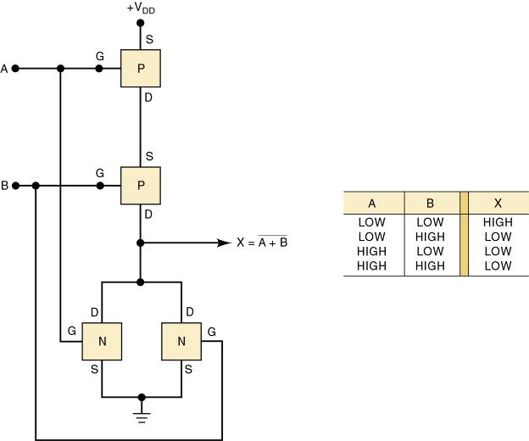
8-8 Complementary MOS Logic
A CMOS NOR gate.
Formed by adding a series P-MOS and a parallel N-MOS to the basic INVERTER.
Digital Systems: Principles and Applications, 11/e
Ronald J. Tocci, Neal S. Widmer, Gregory L. Moss

Slide 13
8-8 Complementary MOS Logic
Two CMOS NOR gates or NAND gates can be cross-coupled to form a simple SET-RESET latch
Additional gating circuitry is used to convert the basic SET-RESET latch to clocked D and J-K flip-flops.
Digital Systems: Principles and Applications, 11/e
Ronald J. Tocci, Neal S. Widmer, Gregory L. Moss

Slide 14
8-9 CMOS Series Characteristics - Terms
CMOS ICs provide all TTL logic functions, and special-purpose functions not provided by TTL.
Terms used when ICs from different families or series are to be used together or as replacements.
Pin-compatible—two ICs are pin-compatible when their pin configurations are the same.
Functionally equivalent—ICs are functionally equivalent when the logic functions they perform are exactly the same.
Electrically compatible—ICs are electrically compatible when they can be connected directly to each other without special measures to ensure proper operation.
Digital Systems: Principles and Applications, 11/e
Ronald J. Tocci, Neal S. Widmer, Gregory L. Moss

Slide 15
8-9 CMOS Series Characteristics – IC Series
The oldest CMOS series is the 4000 series by RCA—functionally equivalent to Motorola 14000.
Rarely used in new designs except when a special-purpose IC is not available in other series.
The 74HC/HCT series has a 10-fold increase in switching speed, comparable to 74LS devices.
Pin-compatible with, functionally equivalent to TTL ICs with the same device number.
The 74AC/ACT series is often referred to as ACL for advanced CMOS logic.
Functionally equivalent various TTL series, but not pin-compatible with TTL.
Digital Systems: Principles and Applications, 11/e
Ronald J. Tocci, Neal S. Widmer, Gregory L. Moss

Slide 16
8-9 CMOS Series Characteristics – IC Series
Series 74AHC/AHCT offers a natural migration path from the HC series to faster, lower-power, low-drive applications.
Three times faster, with similar noise immunity to HC without the over- under-shoot problems.
BiCMOS combines the best of bipolar & CMOS
Characteristics are integrated to produce an extremely low-power, high-speed logic family.
Limited to functions used in microprocessor and bus interfacing applications.
Digital Systems: Principles and Applications, 11/e
Ronald J. Tocci, Neal S. Widmer, Gregory L. Moss

Slide 17
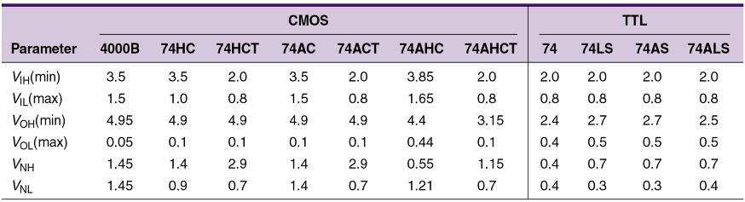
8-9 CMOS Series Characteristics – Power
When devices using different supply voltages are interconnected, special measures must be taken.
The 4000/14000 series and 74C series devices operate with V_{DD} values ranging from 3 to 15 V.
74 series ICs operate over a much narrower range of supply voltages—typically between 2 and 6 V.
Lower-voltage series (2.5 or 3.3 V) are available.
Digital Systems: Principles and Applications, 11/e
Ronald J. Tocci, Neal S. Widmer, Gregory L. Moss

Slide 18
8-9 CMOS Series Characteristics – Power
In general, CMOS devices have greater noise margins than TTL.
When a CMOS logic circuit is in a static state—not changing—its power dissipation is extremely low.
Ideally suited for applications using battery power.
Power dissipation of a CMOS IC will be very low as long as it is in a dc condition.
P_{D} will increase in proportion to the frequency at which the circuits are switching states.
Digital Systems: Principles and Applications, 11/e
Ronald J. Tocci, Neal S. Widmer, Gregory L. Moss

Slide 19
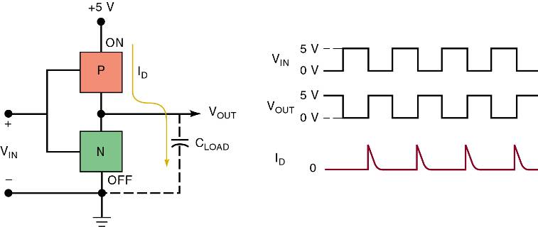
8-9 CMOS Series Characteristics – Power Dissipation
Each time a CMOS output switches from LOW to HIGH, a transient charging current must be supplied to the load capacitance.
The combined input capacitances of any loads being driven and the device’s own output capacitance.
Current spikes are drawn from V_{DD} each time the output switches from LOW to HIGH.
Digital Systems: Principles and Applications, 11/e
Ronald J. Tocci, Neal S. Widmer, Gregory L. Moss

Slide 20
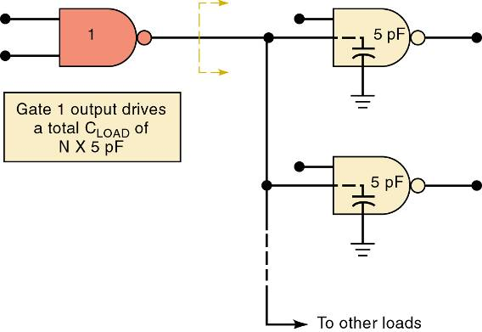
8-9 CMOS Series Characteristics – Fan-Out
CMOS inputs have an extremely large resistance that draws essentially no current from the source.
10¹² Ohms.
Each CMOS input, typically presents a 5-pF load to ground.
This input capacitance limits the number of CMOS inputs that one CMOS output can drive.
Digital Systems: Principles and Applications, 11/e
Ronald J. Tocci, Neal S. Widmer, Gregory L. Moss

Slide 21
8-9 CMOS Series Characteristics – Switching Speed
Although CMOS must drive relatively large load capacitances, switching speed is somewhat faster.
Due to low output resistance in each state.
In the CMOS circuit, output resistance in the HIGH state is the R_{ON} of the P-MOSFET.
Typically 1-k Ohms or less.
Digital Systems: Principles and Applications, 11/e
Ronald J. Tocci, Neal S. Widmer, Gregory L. Moss

Slide 22
8-9 CMOS Series Characteristics – Static Sensitivity
All electronic devices, to varying degrees, are sensitive to damage by static electricity.
MOS logic families are especially susceptible.
Digital Systems: Principles and Applications, 11/e
Ronald J. Tocci, Neal S. Widmer, Gregory L. Moss

Slide 23
8-9 CMOS Series Characteristics – Static Sensitivity
Precautions against Electrostatic discharge:
Connect the chassis of all test instruments, soldering-iron tips, and your metal workbench to earth ground.
Connect yourself to ground with a special wrist strap.
Keep ICs in conductive foam or aluminum foil.
So no dangerous voltages develop between any pins.
Avoid touching IC pins—insert the IC into the circuit immediately after removing from the protective carrier.
Place shorting straps across the edge connectors of PC boards when the boards are carried/transported.
Avoid touching the edge connectors.
Do not leave any unused IC inputs unconnected.
Open inputs tend to pick up stray static charges.
Digital Systems: Principles and Applications, 11/e
Ronald J. Tocci, Neal S. Widmer, Gregory L. Moss

Slide 24
8-9 CMOS Series Characteristics – Switching Speed
Unavoidable existence of parasitic (unwanted) PNP and NPN transistors embedded in CMOS substrate can cause a condition called latch-up.
If triggered, they will latch-up (stay ON permanently), and a large current will destroy the IC.
Most modern CMOS ICs are designed with protection circuitry that helps prevent latch-up
It can still occur when the device’s maximum voltage ratings are exceeded.
Latch-up can be triggered by high-voltage spikes or ringing at the device inputs and outputs.
Digital Systems: Principles and Applications, 11/e
Ronald J. Tocci, Neal S. Widmer, Gregory L. Moss

